Slide 1

Team Celestial
PRESENTATIONS!
Business website
Notes:
To use this title animation slide with a new image simply 1) move the top semi-transparent shape to the side, 2) delete placeholder image, 3) click on the picture icon to add a new picture, 4) Move semi-transparent shape back to original position, 5) Update text on slide.

Slide 2
“IF YOU WANT SOMEONE TO REMEMBER YOUR MESSAGE – IN A PRESENTATION, AN ARTICLE, OR A REPORT–
TELL THEM A STORY.”
—RACHEL GILLETT, FAST COMPANY

Slide 3
INTRODUCTION
Our mission
To help people shopping. Getting information and know more about smartphone product
We will present about our process of making a business website
Let us share some incidents so as many issue during the process of creating a website
What story do you want us to tell?

Slide 4
PREPARE
In the beginning, everything is just like a dream
Collect information about the project
In the beginning of our project, everything work just fine...
Analyze the request
We understand the question and understand what we need to do
Function list
We create everything that we need to build and give work for everyone

Slide 5
DESIGN
Thing go so smooth
Design user interface
After go though many different website, we finally finish the UI for the web
Design the database
As a team, we quickly agreed the way that we will do the database

Slide 6
DATABASE NOT UNIFIED & WRONG IMAGE SIZE
Thing go wrong
!
As a team, we miscommunicate and that lead to a problem that database designer have different idea with developer, that lead to some problem about database and image size

Slide 7
TIME GO BY SO FAST… We divided the work individual and then send to dev
(after finished the damn error)
1
2
3
4
5
Code some HTML and CSS code
Code functions of transaction of website
Code mainly function of user
Code admin page and some admin function
Main dev – code important & hard function of the web and gather all the code to the web
Reference : The basics you can find anywhere 5 Steps To Successful Storytelling Published on April 5, 2014 Featured in: Marketing & Advertising

Slide 8
In the flow| All about the time
ISSUE
(Again)
Deadline come but the web still in development as thing go wrong in breakdown work, wrong idea of the design, lack of knowledge making a website, some server down

Slide 9
TEST
Thing mostly okay now
Get access to the web
Go through the website, recheck all the function that is required in the beginning of the project
Test case
The last thing that every member has been waiting for

Slide 10

1
Effective work, Always on time, great listener, open mind but not pay enough attention
LE DUC ANH
Leader of team
Greater power mean greater responsibility

Slide 11

2
Nice data gather and sharing, good attitude, on time. Should listen more and be more careful
PHAM XUAN BACH
Tester of the team

Slide 12
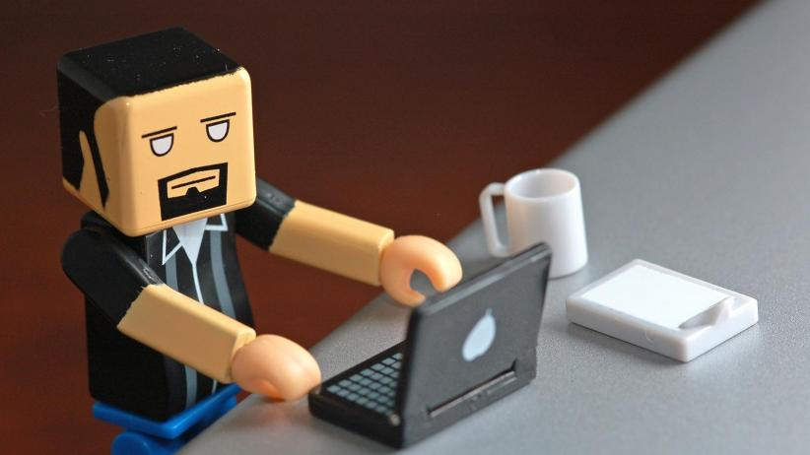
3
Sharing and caring, but need to be more on time
NGUYEN NGUYEN HOANG
Developer of the team
Notes:
Tip:
When using complex image as full-bleed background add a transparency (70%-90%) fill layer to give contrast to text.

Slide 13

4
Nice work art, calm, on time and carefulness person. Need to pay attention of other member to keep track
LE HOANG HUY
Designer of the team
A picture is worth a thousand words…

Slide 14

5
Energetic, always ready, on time and have great vision toward the project. But some time miscommunicate with team
PHAM THIEN AN
Database developer of the team

Slide 15

ABOUT THE TEAM
ASK
Attitude
We did have great time during the process with good communication, sharing and caring
Skill
Know what we have and what we don’t have to enhance our skills as so as develop new skills
Knowledge
We did have some issue in the beginning due to the lack of knowledge but after we work as a team, most of all problem solved
Notes:
Combine an image and multiple key statements with a strong grid.

Slide 16
In the end, during the subject and project, we learn, we ask, we develop skills and after all, we think that not only the website that was created but also the skill and knowledge that we need in the future.
WE HAVE ALL NOW TRULY BECOME A TEAM .
— Celestial

Slide 17
TEAM CELESTIAL The end!
THANK YOU FOR LISTENING

